Slide 1


Lecture 1:
Introduction and Math/Python Review
McGill Artificial
Intelligence Society
Notes:
HYPE!!!!!!!
Where is everybody from and what school
When did they arrive

Slide 2
Today’s Agenda
Who are we?
Course Overview
Environment Setup
Python Review and Practice
Math Review and Numpy Introduction
Math Implementation Assignment

Slide 3
Who are we?

Slide 4


The Mentors
McGill Artificial
Intelligence Society
Tiffany Wang
McGill H Electrical 19’
Software Engineer
Google
Frank Ye
McGill Electrical 19’
ML Engineer
Splunk
John Wu
McGill Computer 19’
Product Manager
Microsoft

Slide 5



The Mentors
McGill Artificial
Intelligence Society

Slide 6




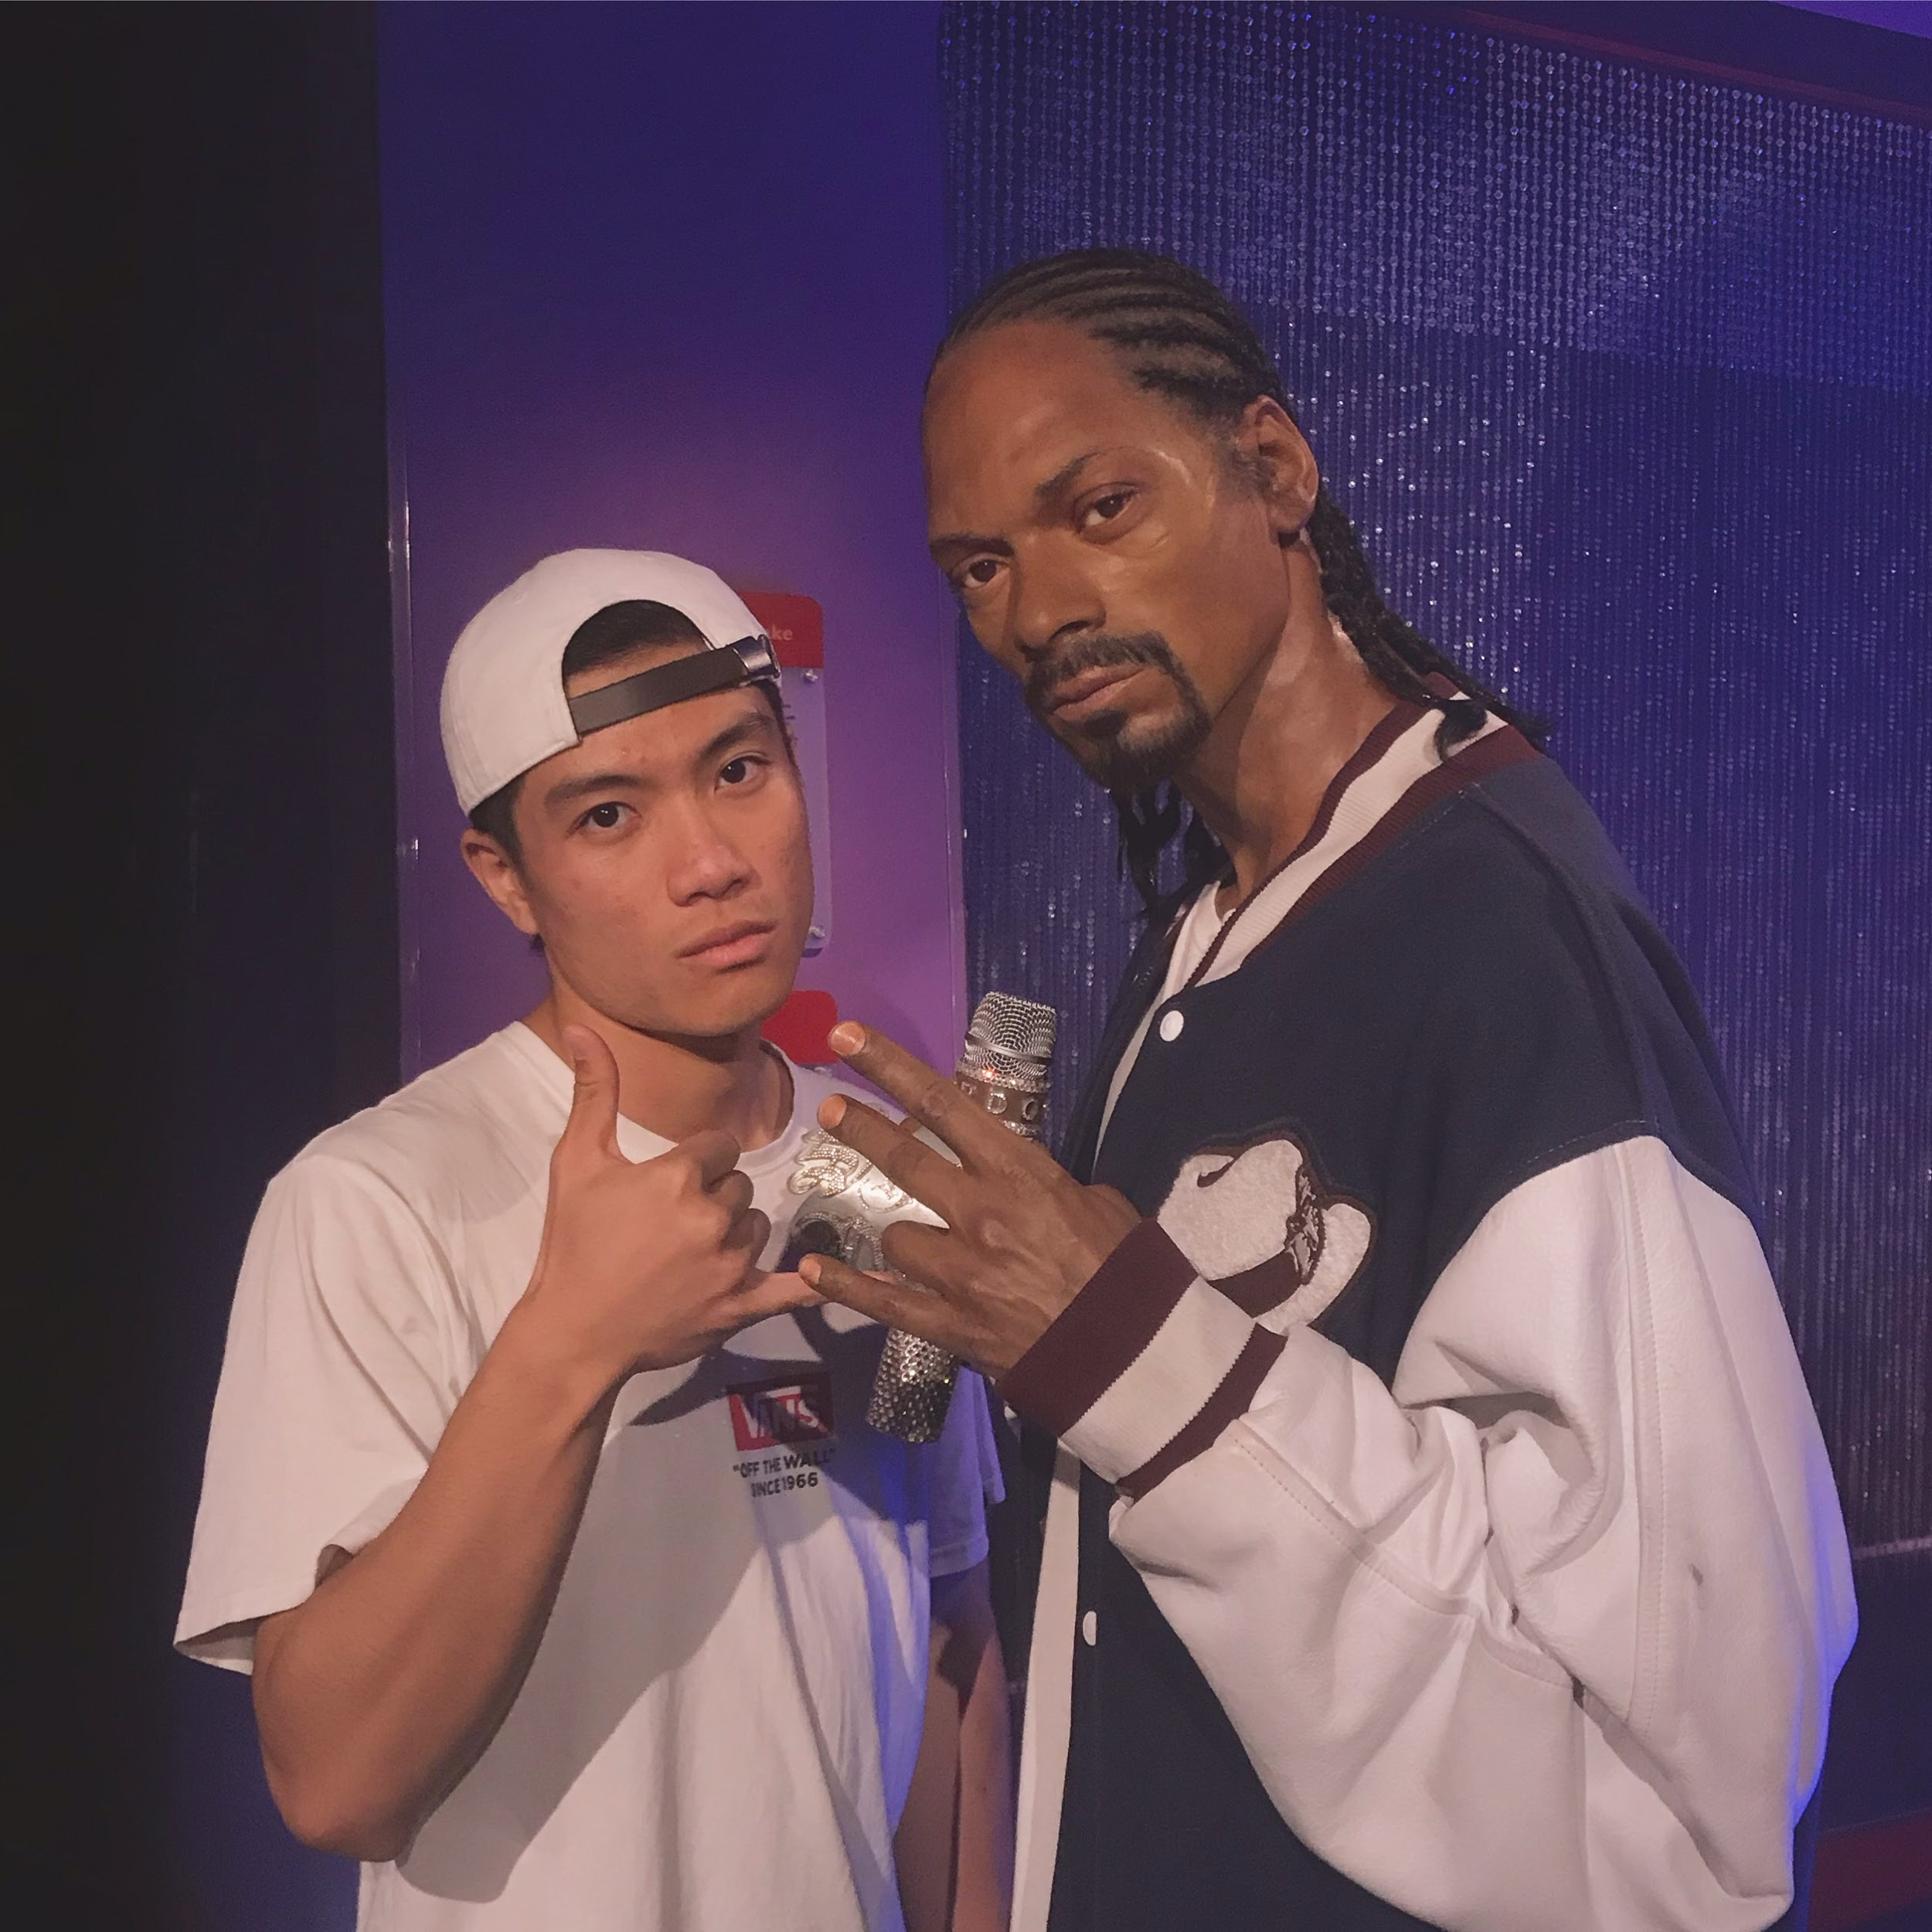

The Assistant Lecturers (ALs)
Ying
Ocean
Hiroshi
Head TA
Ranley
Steven
Lucas

Slide 7
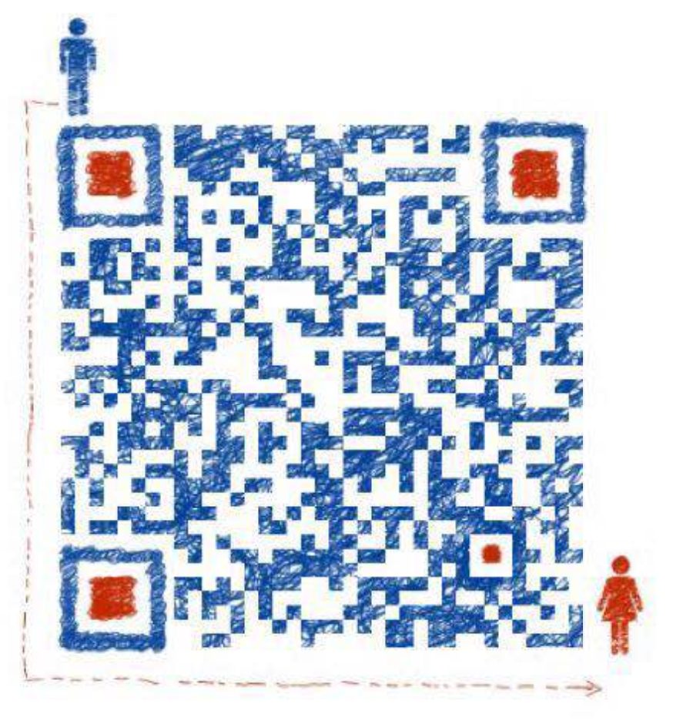





The Assistant Lecturers (ALs)
Hiroshi
Ying
Ocean
Ranley
Steven
Lucas

Slide 8
Course Overview

Slide 9
Where is Artificial Intelligence being used in China?
Notes:
Depending on who you ask, the definition of the terms AI, ML have gotten so blurred by hype, media coverage
AI: Artificial Intelligence is a broadly used term that defines the entire field of algorithms that can accomplish tasks that it wasn’t explicitly programmed to do. Historically, AI used much simpler techniques than the algorithms we use today, focusing on parsing all possible actions using trees and applying various forms of heuristics (or KPIs) in order to speed up the algorithms.
ML: Machine Learning became increasingly popularized since the rise of big data. Machine Learning largely differs from the tree parsing techniques used historically, by being a very statistically driven approach. In Machine Learning, the algorithms take in a large amount of data, and try to find important trends or information within that data before inferring what we’re looking for.
DL: Deep Learning is a subfield in machine learning in that it is also very data driven. What differs is that instead of using classical statistical methods (i.e. linear regression, gaussian mixture models, etc.) it uses the currently very popular neural network. The neural network, which was originally inspired by the human brain, has since diverged from biology and has found much of its new success from improvements in its theoretical guarantees, that is, it has proven to perform well on practical applications.

Slide 10

Facial Recognition for Alipay
Image Credits

Slide 11

Voice to Text in Bullet Messenger
Image Credits

Slide 12

Ping An’s One-Minute Clinic
Image Credits

Slide 13

Defining Artificial Intelligence
Notes:
Depending on who you ask, the definition of the terms AI, ML have gotten so blurred by hype, media coverage
AI: Artificial Intelligence is a broadly used term that defines the entire field of algorithms that can accomplish tasks that it wasn’t explicitly programmed to do. Historically, AI used much simpler techniques than the algorithms we use today, focusing on parsing all possible actions using trees and applying various forms of heuristics (or KPIs) in order to speed up the algorithms.
ML: Machine Learning became increasingly popularized since the rise of big data. Machine Learning largely differs from the tree parsing techniques used historically, by being a very statistically driven approach. In Machine Learning, the algorithms take in a large amount of data, and try to find important trends or information within that data before inferring what we’re looking for.
DL: Deep Learning is a subfield in machine learning in that it is also very data driven. What differs is that instead of using classical statistical methods (i.e. linear regression, gaussian mixture models, etc.) it uses the currently very popular neural network. The neural network, which was originally inspired by the human brain, has since diverged from biology and has found much of its new success from improvements in its theoretical guarantees, that is, it has proven to perform well on practical applications.

Slide 14
What will you specifically learn?
Common tools, languages, and frameworks used in machine learning.
Study and implementation of traditional and popular machine learning algorithms.
Introduction to deep learning through feed forward and convolutional neural networks.
Integration of machine learning in an end-to-end product by creating a pokemon classifier web app.
All these will require extensive usage of your existing mathematical and coding knowledge.

Slide 15
Lecture Schedule
Day 1 | Python and Math Review
Day 2 | Data Manipulation and Visualization
Day 3 | Introduction to ML and Data Preprocessing
Day 4 | Linear and Logistic Regression
Day 5 | KNNs, Decision Trees, and Ensemble Methods
Day 6 | SVMs and PCA
Day 7 | Feed Forward Neural Networks
Day 8 | Convolutional Neural Networks
Day 9/10 | Pokemon Classifier Web Application

Slide 16
Daily Structure
Theoretical Lecture (~ 1-1.5 Hours)
Live Implementation/Visualizations (~ 0.5 - 1 Hour)
In-Class Individual Assignment (~ 2 Hours)
Evening Homework / Lab Hour (< 1 Hour)

Slide 17
House Rules
If you have related questions during the lectures, ASK!
If you have questions while working on individual assignments, do a quick search on the internet first AND THEN ask if you don’t find the solution.
If you have questions outside of class, message in the WeChat class group chat (not individually, unless the question is very specific).
You may (and you should) collaborate with each other on individual assignments, but simply copying each other will not bring you any benefit from the course.

Slide 18
Environment
Setup

Slide 19
Python
You should have installed python during the pre-assignment coding component.
Type the following in terminal to ensure you have python version 3.5+ installed:
python --version
Does anyone not have python installed?
https://www.python.org/downloads/

Slide 20
Download Repository
Clone course repository if you have experience with git:
git clone https://github.com/McGillAISociety/TechX

Slide 21
IDE
You should have installed python during the pre-assignment coding component.
Open the course content folder in your IDE:
File > Open > Choose Project Folder
Does anyone not have an IDE installed?
https://code.visualstudio.com/

Slide 22
Example Code
We will now run the example code to ensure you have a proper working environment for the course.
Open a terminal window and navigate to the project repository folder.
Run pip install -r requirements.txt to install packages.
Run python hello-techx.py to execute the program.

Slide 23
Python
Review

Slide 24

Why Python?
1 Open Source Libraries
Common tasks are already scripted into easily usable packages.
2 Simplicity
Syntax is extremely easy to learn and very similar to english language. Focus on problem and not syntax.
3 High Level
High level language which abstracts lots of theoretical concepts such as memory management.
4 Portable
Supported by all modern operating systems, allowing you to easily transfer code between machines.
5 Embeddable
If you have an application written in other languages, you can easily add in python snippets.
6 Interpreted
Syntax is interpreted at runtime so that you don’t need to compile the code before.

Slide 25
Jupyter Notebook

Slide 26
At a quick glance
Open-source web app that allows you to create and share documents with:
Live code
Equations
Visualization
Text
Most importantly, runs in Python
jupyter notebook
localhost:8888 (default port)
Notes:
Followed by a quick demonstration of what is jupyter notebook

Slide 27

The Syntax Comparing
To Java

Slide 28
Print Statements
Java
System.out.println(“Hello”);
System.out.print(“Hello”);
String x = “Hello”;
String y = “World”;
System.out.println(x+y);
Python
print(‘Hello’)
print(‘Hello’, end=‘’)
x = ‘Hello’
y = ‘World’
print(x+y)

Slide 29
Declaring Variables
Java
String str = “Hello World”;
int x = 23;
double y = 45.5;
Boolean value = true;
Python
str = ‘Hello World’
x = 23
y = 45.5
value = True
Only In Python
str, x, y, value = ‘Hello World’, 23, 45.5, True

Slide 30
Arrays (Java) - Lists (Python)
Java
Int[] arr = new int[4];
Arr[0] = 2;
Arry[1] = 4;
String[] str = { “Hi”, “World”};
Python
arr = [None] * 4
arr[0] = 2
arr[1] = 4
str = [‘Hi’, ‘World’]
Only In Python
arr = []
arr.append(4)
mixArr = [ 2, 4.5, ‘Hello’, true]

Slide 31
Hashmaps (Java) - Dictionaries (Python)
Java
HashMap<String, Integer> map = new HashMap<String, Integer>();
map.put(“John”, 12345);
int id = map.get(“John”);
Python
dict = {}
dict[‘John’] = 12345
id = dict[‘John’]

Slide 32
If/Else Statements
Java
int x = 5;
if (x > 5) {
// do something
} else if (x == 5) {
// do something
} else {
// do something
}
Python
x = 5
if x > 5:
# do something
elif x == 5:
# do something
else:
# do something

Slide 33
For Loops
Java
int[] a = {4, 5, 6, 7};
for (int i=0; i<a.length(); i++) {
System.out.println(a[i]);
}
for (int item: a) {
System.out.println(item);
}
Python
a = [4, 5, 6, 7]
for x in range(len(a)):
print(a[x])
for item in a:
print(item)

Slide 34
While Loops
Java
int n = 0;
while (n < 10) {
n++;
}
Python
n = 0;
while n < 10:
n += 1

Slide 35
Declaring Methods
Java
public int getSum(int x, int y) {
int sum = x + y;
return sum;
}
int s = getSum(2, 3);
Python
def getSum(x, y):
sum = x + y
return sum
s = getSum(2, 3);
Only In Python
def getSumAndProduct(x, y):
sum = x + y
product = x * y
return sum, product
s, p = getSumAndProduct(2,3)

Slide 36
Hello World Example
Java
public class Test {
public static void main(String[] args) {
System.out.println(“Hello World”);
}
}
Python
print(‘Hello World’)

Slide 37
Let’s Practice!
Write some code that does the following:
Loop (use while or for loops) all numbers from 0 to 100.
For each number:
Print “Fizz” if the number is a multiple of 3 (and not 5).
Print “Buzz” if the number is a multiple of 5 (and not 3).
Print “FizzBuzz” if the number is a multiple of both.
Put this code into a method and call it from a main class.

Slide 38
Math Review
Notes:
线性代数

Slide 39
Why use Linear Algebra in Machine Learning?
Complex machine learning models deal with high dimensional inputs, which are a lot more easily interpreted in a matrix form
Images (in Computer Vision) are usually represented by matrices with numeric values for each color
Easy to perform geometric transformations on matrices
(eg. translation, rotation, resizing, scale, etc …)
Certain matrix properties simplify data analysis
Notes:
Machine Learning is essentially matrix transformation

Slide 40
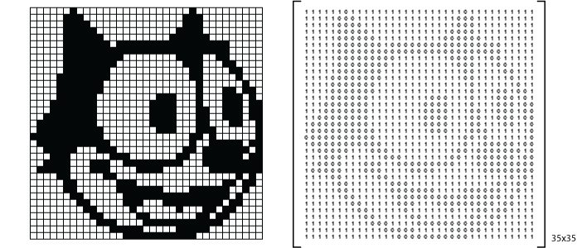
Example of Image Matrices

Slide 41
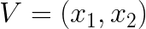
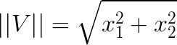
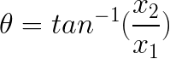
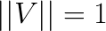
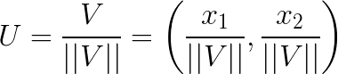
Vector Review
Magnitude
Orientation
x2
𝜗
Unit vector, if:
x1
U is the unit vector of V
It shares the same orientation as V
Notes:
Ask who had trouble with the prep material
a quantity having direction as well as magnitude, especially as determining the position of one point in space relative to another.
Draw on the board

Slide 42
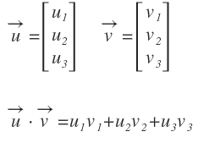
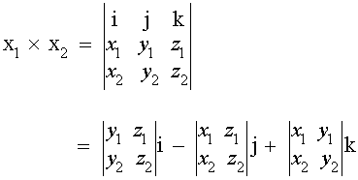
Vector Review (cont’d)
Addition
Scalar Multiplication
Vector Dot Product
Vector Cross Product
Notes:
Add dot product and cross product
Who doesn’t undertand this will have to ask ALs

Slide 43
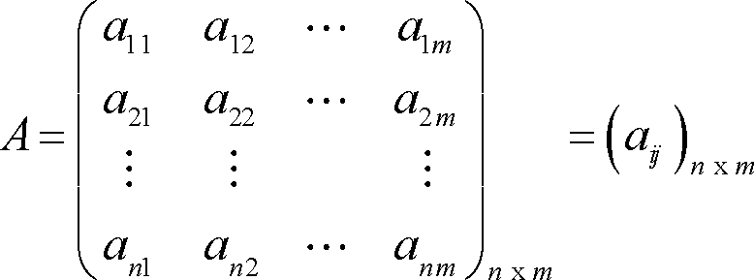
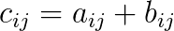
Matrix Review
n rows
m columns
Matrix Addition
A, B and C must share identical dimensions

Slide 44
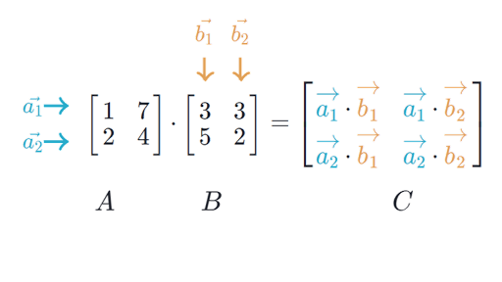
Matrix Review (ct’d)
Matrix Multiplication
Each element in matrix C is a dot product with corresponding row vector from matrix A and column vector from matrix C

Slide 45
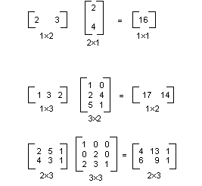
Matrix Review (ct’d)
In matrix multiplication, the number of columns from the first matrix must be identical to the number of rows in the second matrix.
AB ≠ BA

Slide 46
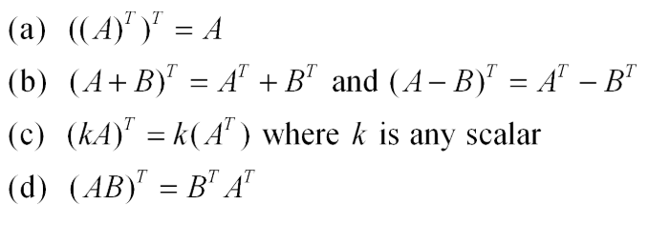
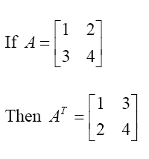
Matrix Review (cont’d) - Multiplication and Transpose
Transpose: The transpose of a matrix is a new matrix whose rows are the columns of the original

Slide 47

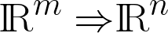
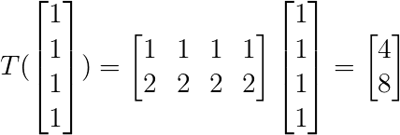
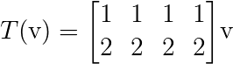
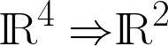

Linear Transformation
High-level: linear mapping between two modules
This includes vector space mapping
Linear means that it preserves scalar and addition operations
Notes:
In practice. High dimensional data → compact on high matrices
operations on high D data at once, you’re applying. Linear transformation.

Slide 48
Linear Transformation

Slide 49

Linear Transformation

Slide 50
Dimensions must match for Linear Transformation operations to work.

Slide 51
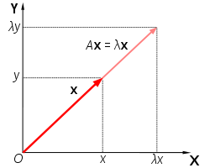
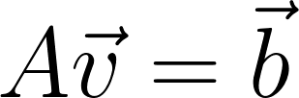
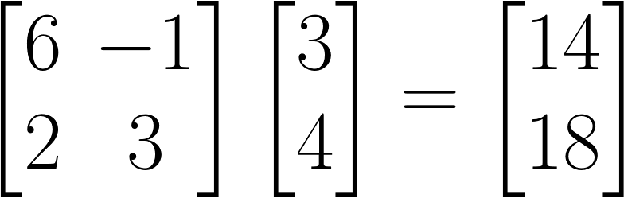
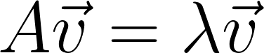
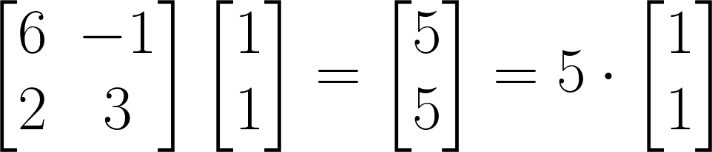
Eigenvalues and Eigenvectors
Important Concept Used in Algorithms such as PCA
Linear transformation
Special case where
= eigenvalue
= eigenvector
Notes:
PCA: lecture 6.
Most of the time, the vector is going to rotate
However, some vector → that does not apply. That will happen instead is that it will be multiplied by a scalar value. So what will happen will stretch or compress. But it will maintain the same direction.

Slide 52

Matrix and Vectors in Python
Optimized and well-maintained scientific computing package for Python (Open Source!)
import numpy as np
Notes:
Computations of the math are DONE FOR YOU!

Slide 53
Basic numpy commands
m = np.array([[1, 2, 3],
[4, 5, 6],
[7, 8, 9]])
print(np.transpose(m)
>>> [[1, 4, 7],
[2, 5, 8],
[3, 6, 9]]
print(m + m)
>>> [[2, 4, 6],
[8, 10, 12],
[14, 16, 18]]
print(2 * m)
>>> [[2, 4, 6],
[8, 10, 12],
[14, 16, 18]]

Slide 54
Basic numpy commands (cont’d)
print(np.sum(m))
>>> 45 #sum of all items in the array
print(np.min(m))
>>> 1 #minimum item of the array
print(np.max(m))
>>> 9 #max item of the array
print(m.shape)
>>> (3, 3)

Slide 55
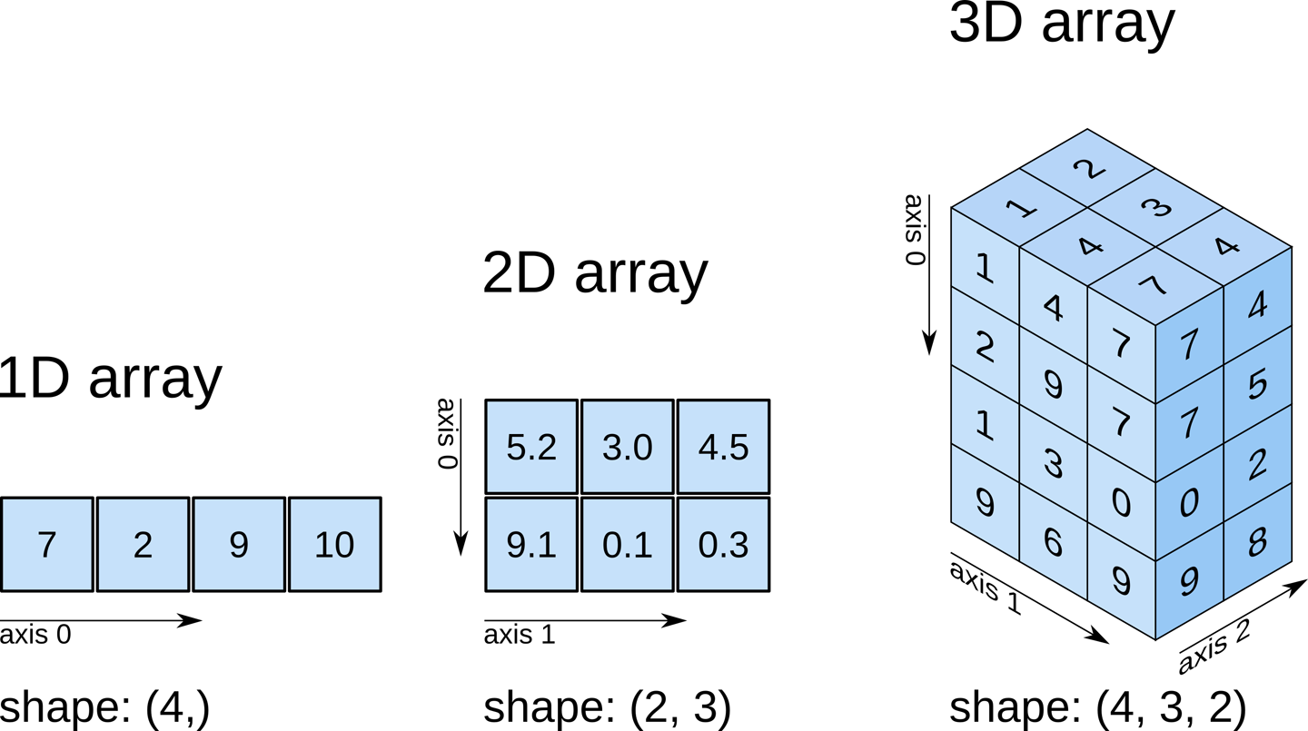
Array shapes

Slide 56
Explore on your own!
Practice makes perfect, and everyone forgets commands!
Numpy Reference Docs

Slide 57
Homework Assignment
Series of math equations to implement using only numpy
Assignment1-Numpy.ipynb

Slide 58
Thanks!
Any questions?
McGill Artificial
Intelligence Society

